Slide 1

Spring of Code
Artificial Intelligence
(Machine Learning & Deep Learning)
Instructor
Asad Ullah
- Research Assistant (DIP Lab)
Duration
03 Months
(Feb – April)

Slide 2

Day 04 – Python Fundamentals (Data Structures)
Objectives:
What is a Data Structure?
Built-in Data Structures in Python
Strings, Lists, Tuples, Sets, Dictionaries
Operations on Data Structures

Slide 3
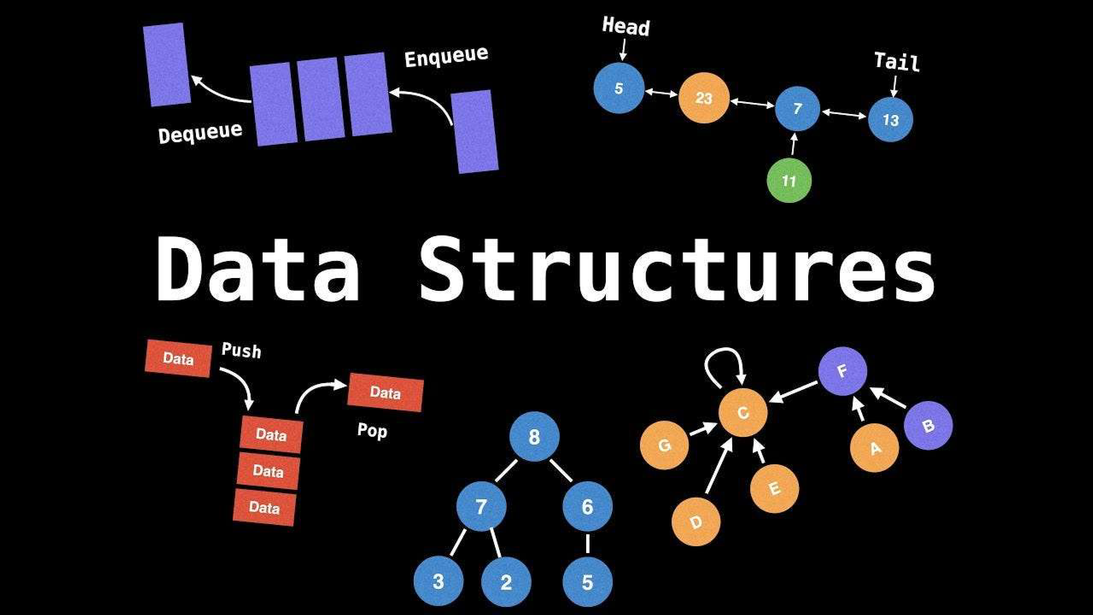

Slide 4
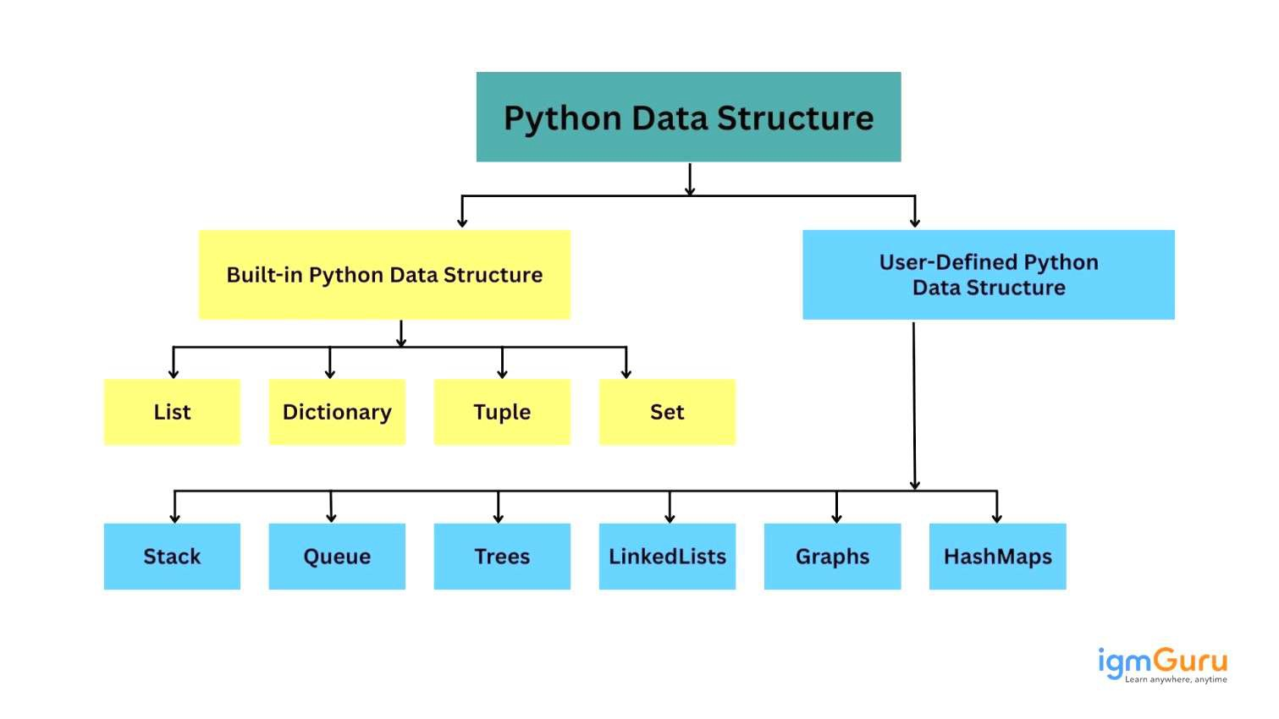

Slide 5
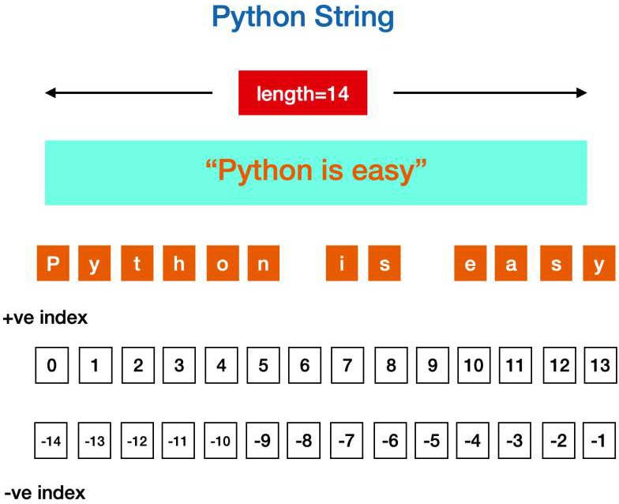

Slide 6
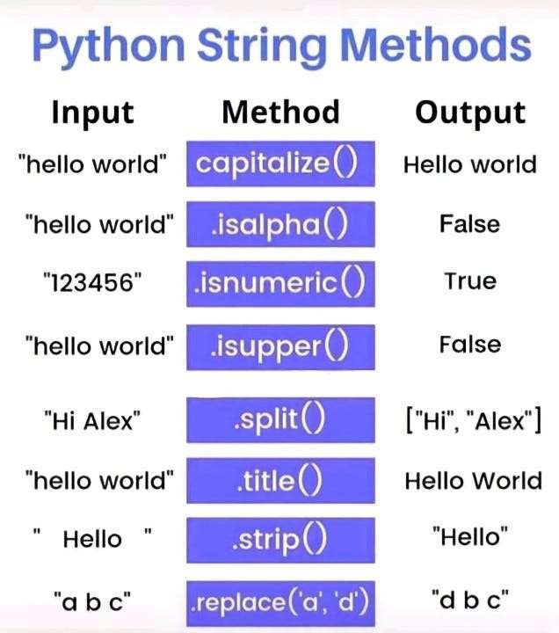

Slide 7
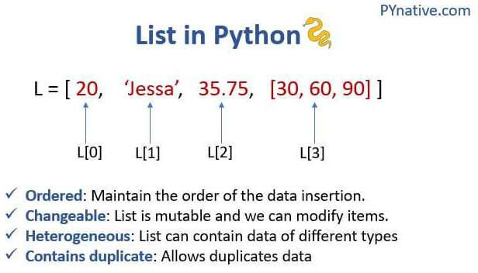

Slide 8
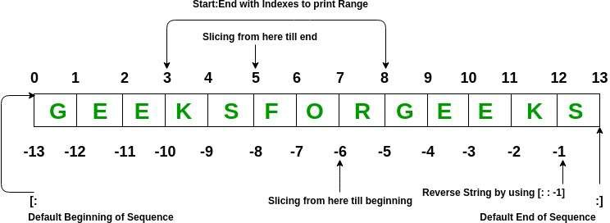
Accessing Items in a List

Slide 9
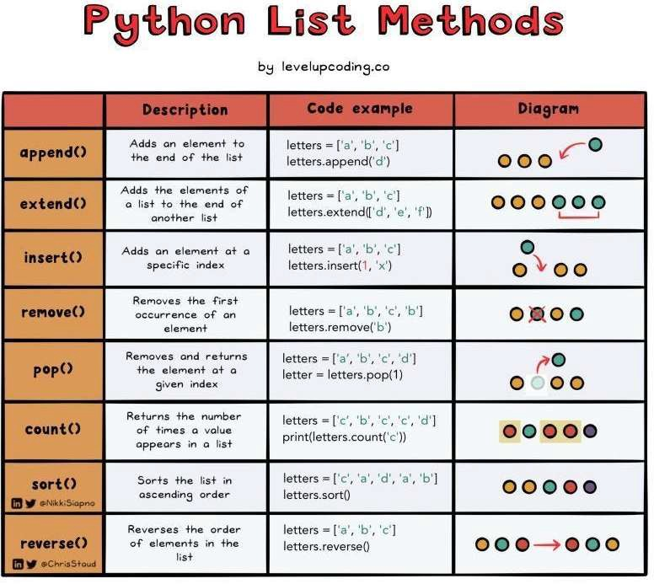

Slide 10
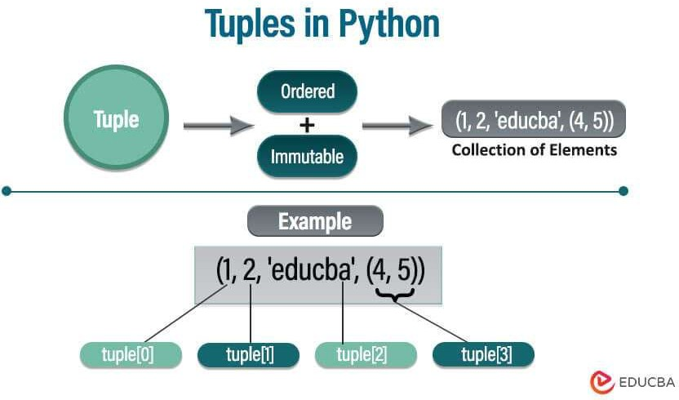

Slide 11
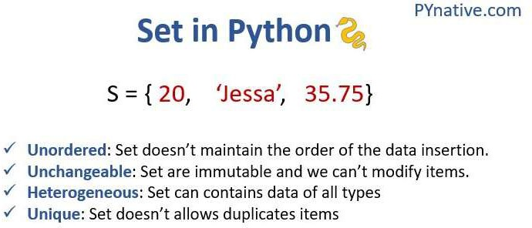

Slide 12
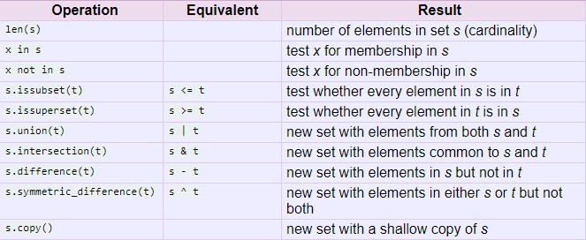
Operations on Set

Slide 13
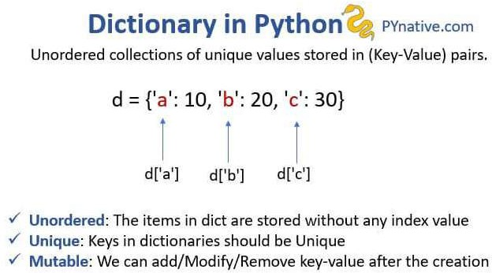

Slide 14
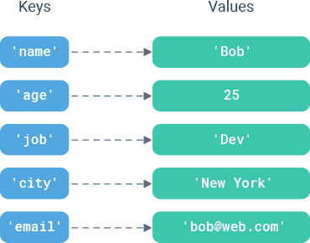
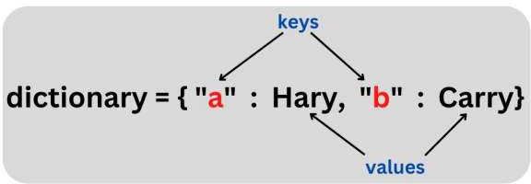
Dictionary in Python

Slide 15

Happy Coding

